Slide 1

CFO Helper: Simplifying Financial Management
A Smart Solution for Today’s Financial Challenges
Discover how CFO Helper empowers finance leaders to make better decisions effortlessly and efficiently.

Slide 2


Agenda for CFO Helper
Here’s a brief overview of the key topics we will cover today.
Problem Statement: Understanding the challenges faced by CFOs today.
Solution Overview: Introducing CFO Helper and its unique approach.
Key Features: Highlighting the essential tools that empower CFOs effectively.
Technology Stack: Exploring the robust technologies behind our platform.
Monetization Strategy: Outlining our revenue-generating plans for sustainable growth.
2

Slide 3


The Problem
Navigating Financial Complexities in Today's Fast-Paced Business Environment
CFOs often deal with overwhelming data that complicates their decision-making processes.
Efficient decision-making tools are essential for CFOs to navigate complexities and provide clear financial outcomes, ensuring that organizations remain competitive and profitable in an ever-evolving landscape.
3

Slide 4


Transforming CFO Operations
Empowering financial leaders with innovative tools for smarter decision-making and streamlined processes.
CFO Helper streamlines processes and enhances clarity for better outcomes. With intuitive features and an emphasis on efficiency, our platform supports CFOs in navigating their financial landscape more effectively.
4

Slide 5



Essential Insights on Financial Management Challenges for CFOs
80% of CFOs report data overload
Our tool simplifies access to key financial information
The increasing complexity of financial data management has left many CFOs overwhelmed. CFO Helper streamlines this process, enabling executives to focus on strategic decisions instead of grappling with excessive information.
5

Slide 6

Robust Frameworks for Success
Pathway - Seamless integration
Flexprice - Adaptive pricing
User-Driven - Meeting client needs effectively
Pathway ensures smooth integration with existing systems for a hassle-free experience.
Flexprice offers adaptive pricing models tailored to client needs, enhancing value and flexibility.
User-Driven focuses on client feedback, enabling continuous improvement and effective solutions for financial challenges.
6

Slide 7
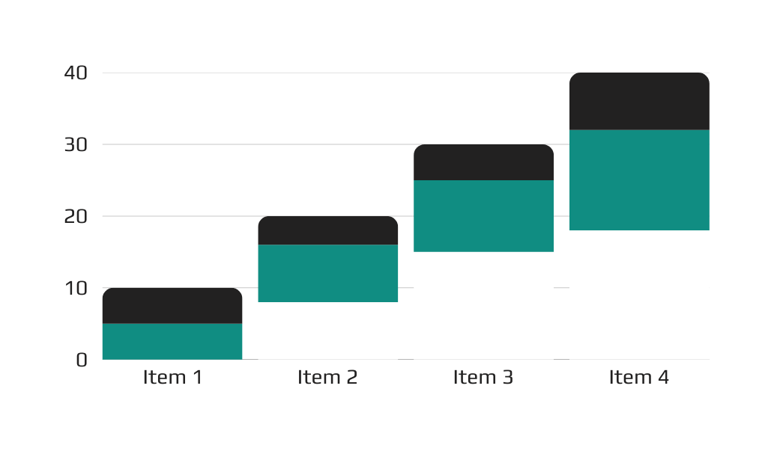
Revenue Generation Plans for CFO Helper
Exploring financial sustainability through diverse revenue generation strategies
Our approach emphasizes recurring revenue models that ensure long-term financial stability and growth for CFO Helper, allowing us to continuously innovate and serve our customers effectively.
Market Research Insights on Financial Tools
7

Slide 8
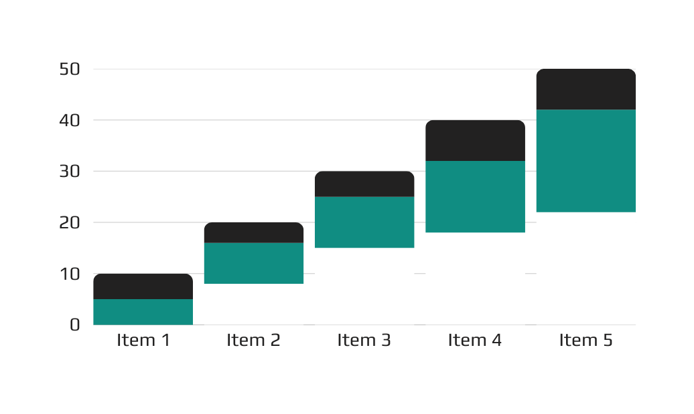
Interactive Prototype Showcase of CFO Helper
Real-Time Capabilities to Enhance Financial Management Efficiency
Witness the tool's impact on financial management as it optimizes processes and provides timely insights, making your decisions smarter and more informed for better outcomes.
Source: Development Team Research and Analysis
8

